Slide 1
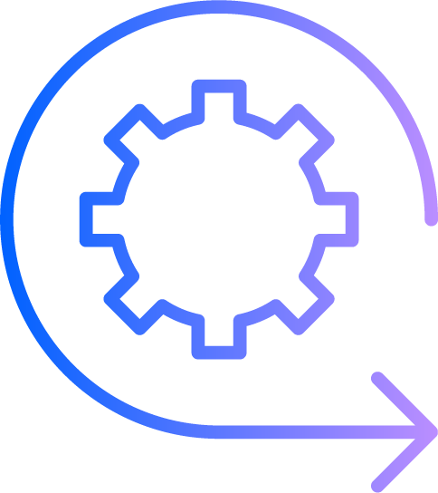

TRIRIGA space management with BIM — Doug Wood TRIRIGA Architect
TRIRIGA Academy

Slide 2








Contents
Revit Definitions | 3
Connector Setup | 6
Space Use Class | 12
Mapping Areas to Rooms | 14
Automatically creating Areas | 15
Validation | 18
TRIRIGA Sub-spaces from Areas | 21
Publish Area Plan | 22

Slide 3
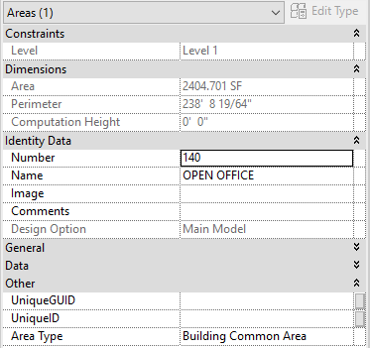
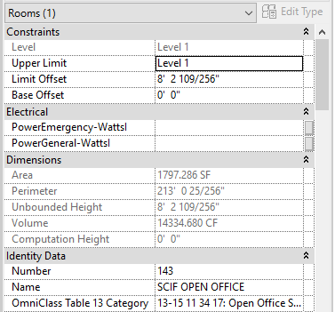
Revit and Space Management – Some definitions
Area –
A Revit Object used to measure area defined by an arbitrary closed polyline drawn on a Area Plan. It also has a Type which is somewhat aligned with BOMA 96. Areas are associated with an Area Plan. They are note used for other architectural calculations
Rooms –
Rooms represent reasonable permeant architectural constructs. Revit associate equipment (assets) with Revit Rooms and Spaces so TRIRIGA assets are associated with Spaces created from these Revit elements. In addition: Revit ties many design calculations to Rooms so their use for space planning may impact other processes
Area Scheme –
A collection of Areas and Area Plans with a common theme. Ex: Gross Measured, Rentable, Circulation zone, By Tenant, etc. Revit support gross area and rentable area Area Schemes which have slightly different behavior
Area Plan –
A plan view of a single Revit level that shows Areas instead of Rooms. Area plans are associated with Area Scheme and only shows Areas associated with the Scheme
There are two ways Revit Spaces can be used by TRIRIGA:
As an alternate source for TRIRIGA Space area values
As a twin for TRIRIGA sub-spaces

Slide 4

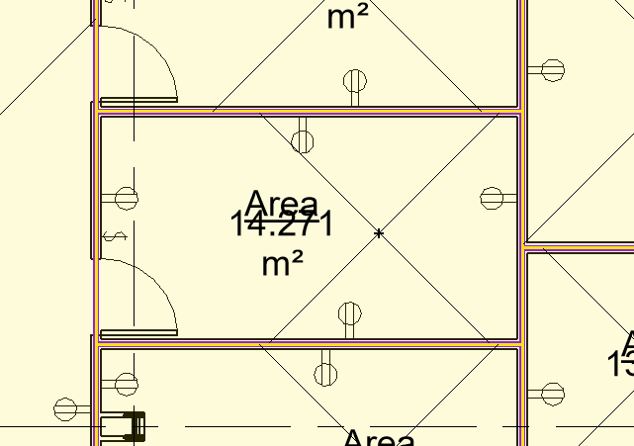
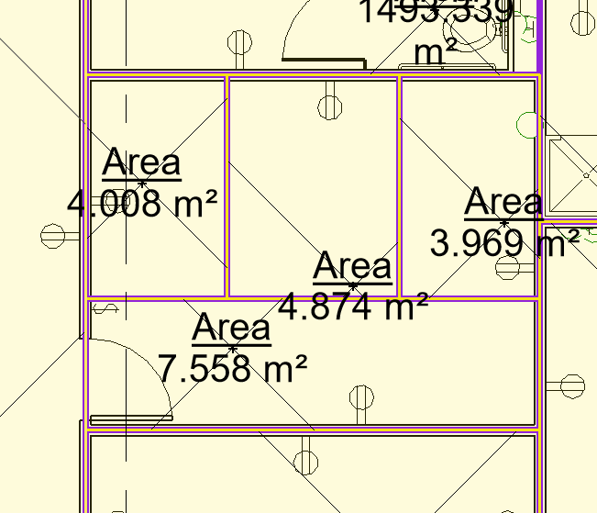
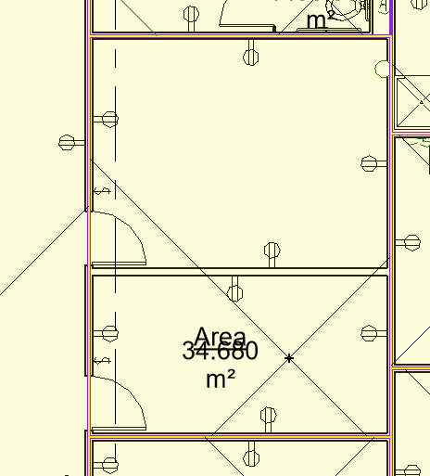
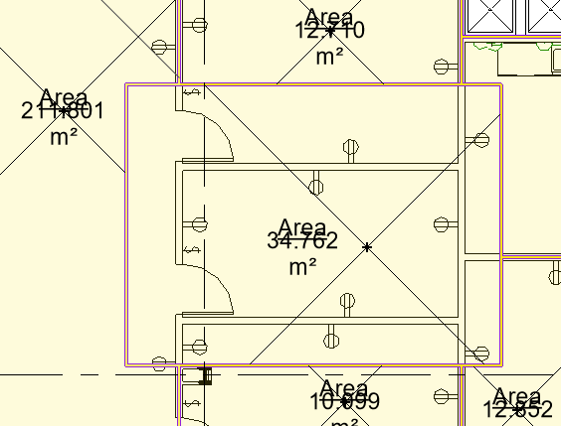
Defining Revit Spaces for user in TRIRIGA
There are 4 cases of how an are can relate to a Room:
1) The area boundaries match the room boundaries
2) A room is comprised of exactly n areas
3) An area is encompassing exactly n rooms
4) Areas are arbitrary: area and room boundaries cross area boundaries
The BIM Connector supports case 1 and 2. Two areas rypes can be associated with a room: gross area, and rentable area. For each area type, the area measurement provided by the area replaces the area measurement from the room.
For Floors, the total area for the gross are plan, if one exists is used for the Floor’s gross area, and if a rentable are plan exists and has been selected in the “Map Areas to Rooms” tool, the total area for the rentable area plan is used for the Floor’s gross measured area.

Slide 5
Why user Revit Areas for Space Management?
They are the element Autodesk designed for space management
Unlike Rooms or Spaces, they aren’t used for anything else so they can be created as needed for space management without disrupting other architectural or engineering calculations
TRIRIGA uses Revit Rooms and Spaces for determining physical asset location
Mapping Areas to TRIRIGA sub-spaces provides a good separation of physical and logical space division

Slide 6

Simplified TRIRIGA Ribbon
If you are using the BIM Connector without access to a TRIRIGA server, such as you are a design or engineering agency preparing a model for hand-over, the Connector can be configure to display a simplified ribbon that only shows the tools usable without access to a TRIRIGA server
Edit TRIRIGA_AR.properties found in C:\ProgramData\IBM\TRIRIGA\AR Integrator\config for a “all user install or the users profile directory for a single user install.
Set Profile=NOLOGIN

Slide 7
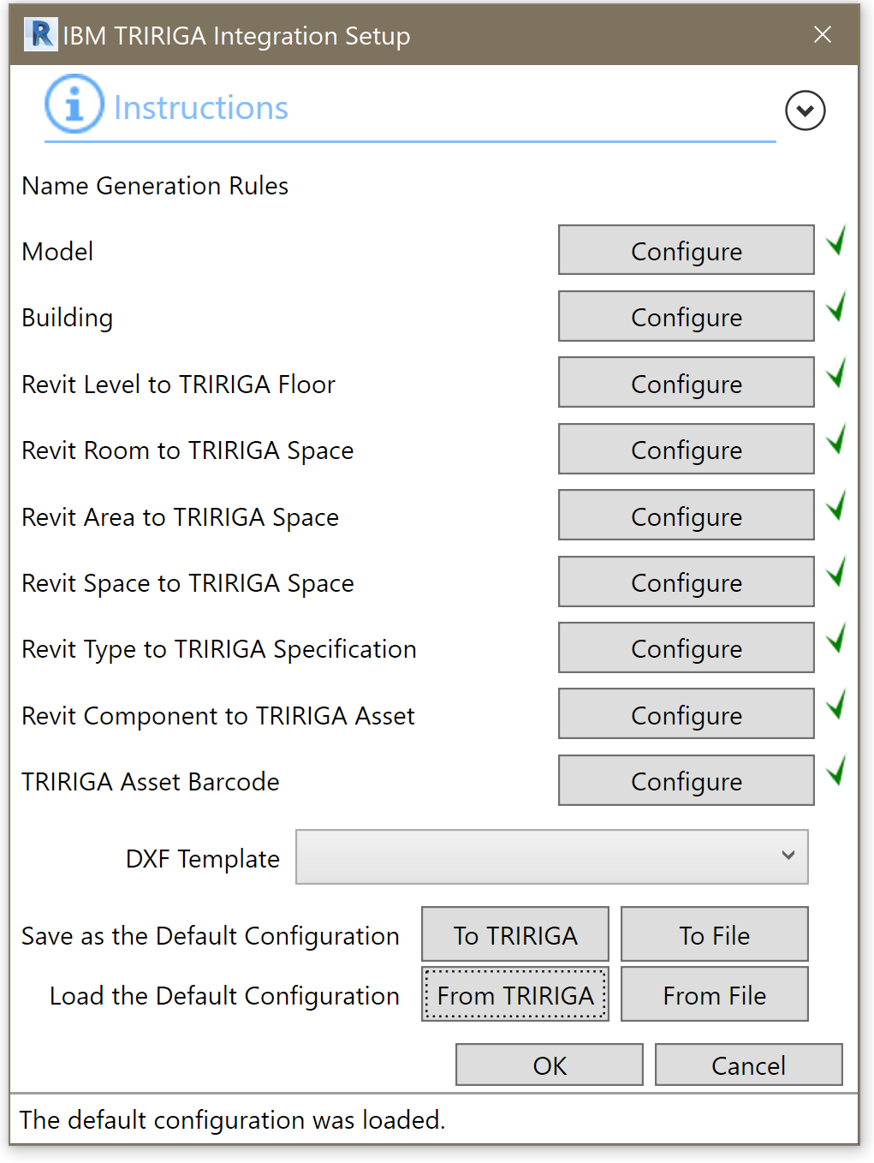
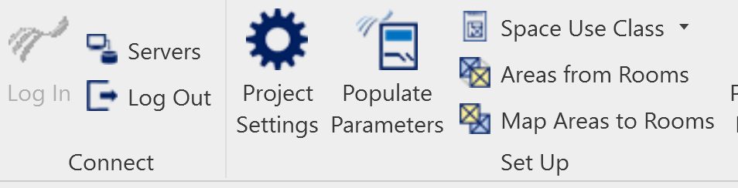
Configure naming rules
If you have access to a TRIRIGA server and settings are stored on the server
Log into TRIRIGA
Naming rules that were loaded from the server and are therefore configured are checked. If any rule is missing, or you want to modify any of the rules you imported, go to the new configuration description
The configuration is stored in the model file
Display the Integration setup form
Load the configuration from the TRIRIGA server
Confirmation that the configuration loaded

Slide 8
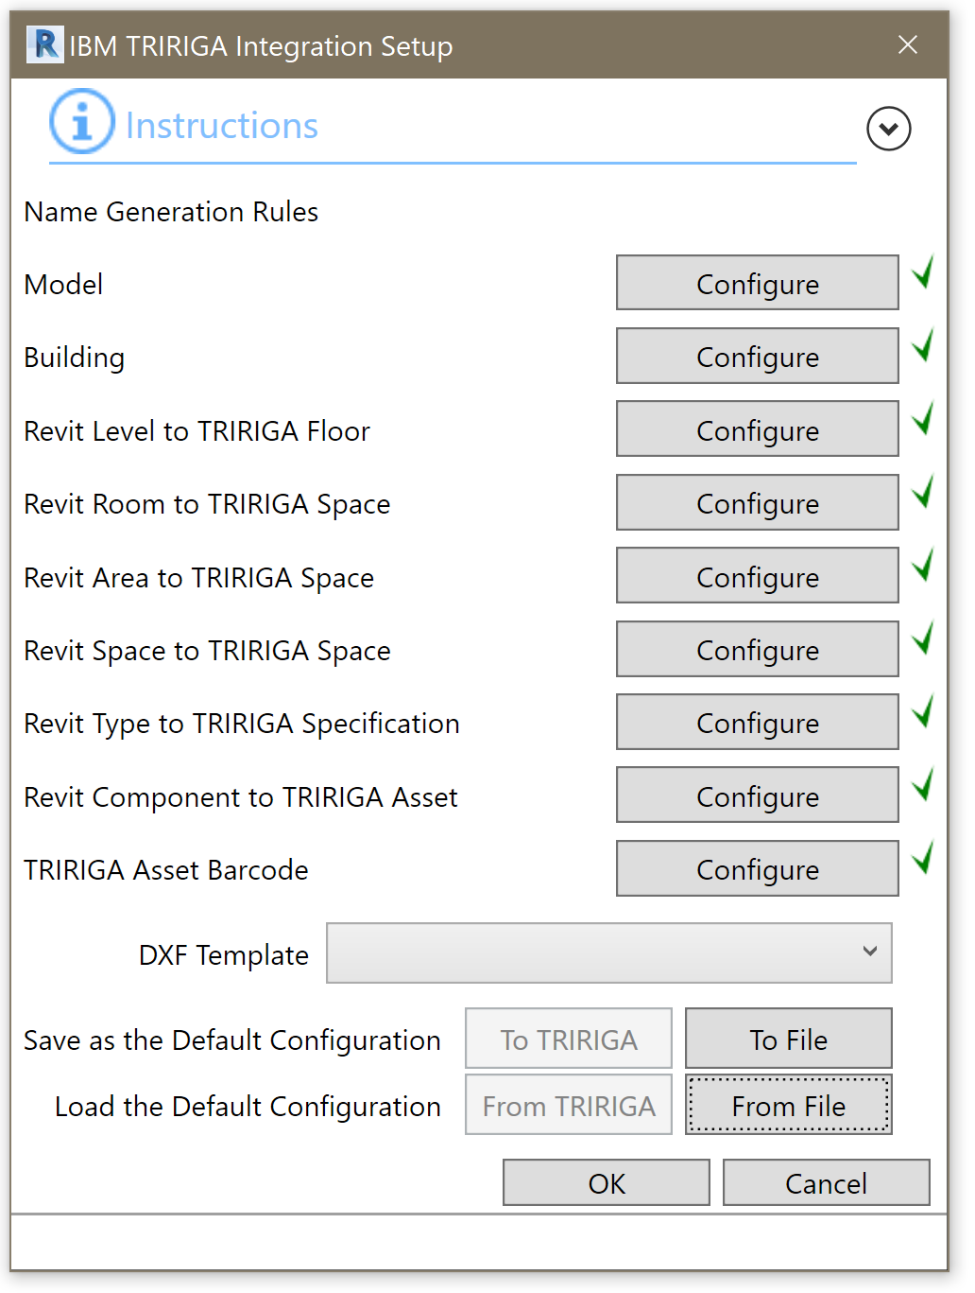
Configure naming rules
If you don’t have access to a TRIRIGA server, and settings are provided to you in a file
It is not necessary to login
Naming rules that were loaded from the file and are therefore configured are checked. If any rule is missing, or you want to modify any of the rules you imported, go to the new configuration description
The configuration is stored in the model file
Display the Integration setup form
Load the configuration from the configuration file you were provided.

Slide 9
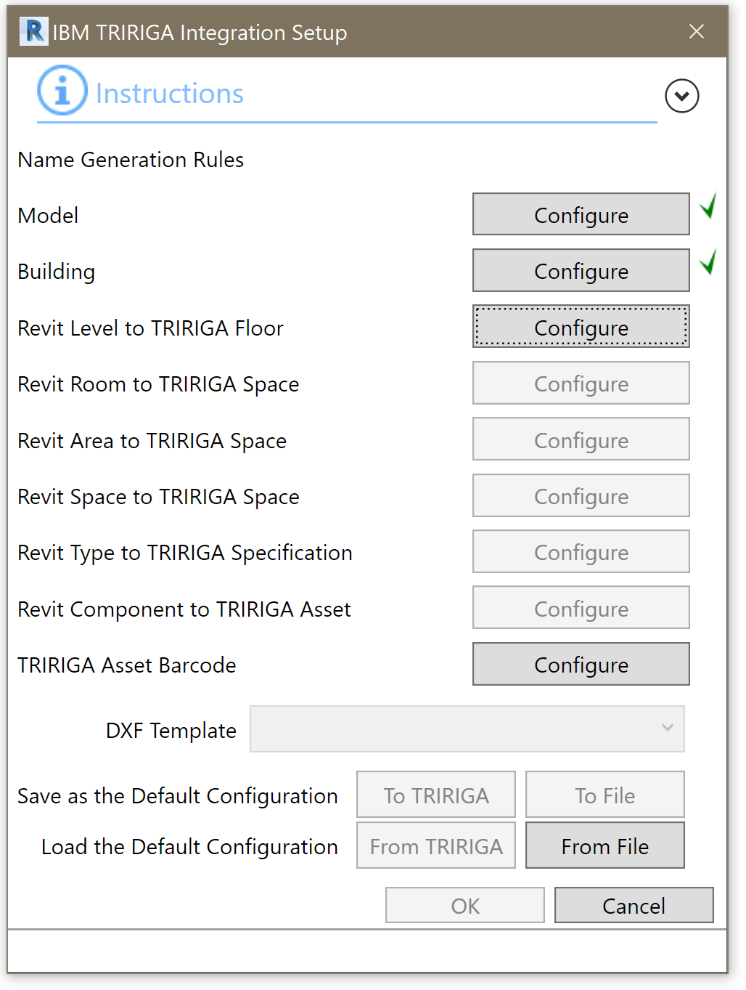
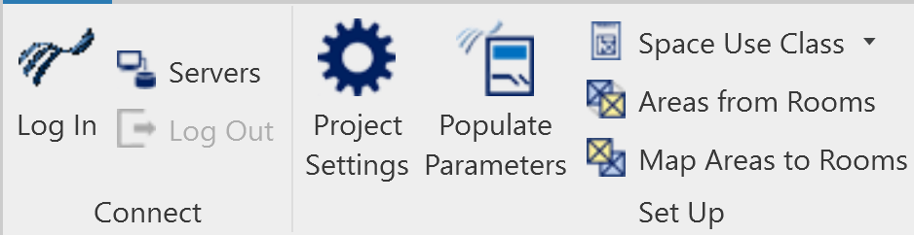
Configure naming rules
If you are defining naming rules for the first time:
Completed rules
It is not necessary to login
Open Name Configuration From
Display the Integration setup form

Slide 10
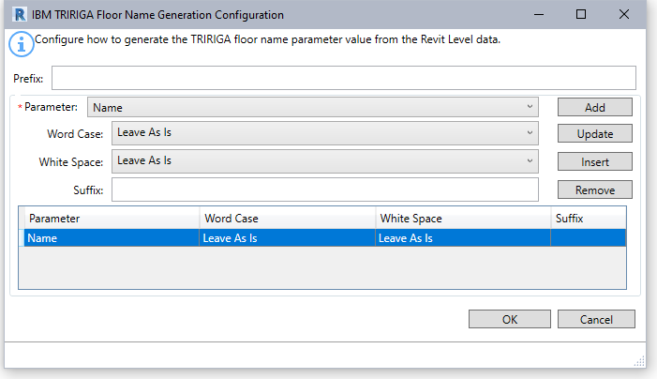
Configure naming rules
Name Configuration Form:
The name of each item created in TRIRIGA by the Connector is controlled by a shared parameters added to each integrate-able elements: IBM.Name.
The name configuration describes how the value of IBM.Name is constructed using the values of other parameters of the element
The Populate parameter tool adds the IBM. Parameters to each integrate-able element and set it value for each element based on the name configuration rule
Applied once at beginning of name
List of all parameters for element family
Transform applied to each parameter value
Appended to end of each parameter value

Slide 11
Sample Naming Rules
Model: <Model file name>
Building <Building name>
Floor: <Name>
Room <Level>-<Name>-Number>
Area <Area Scheme>-<Level>-<Name>-Number>
Space <Level>-<Name>-Number>
Type <Category>-<Type name>
Component: <Category>-<Type name>-<Element Id>
Barcode: <Element Id>

Slide 12

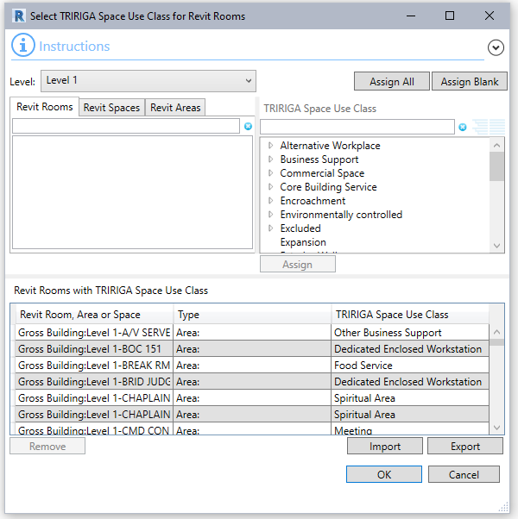
Importing Space Use Class
Space Use Class is maintained on the TRIRIGA server. When the Connector logs into a TRIRIGA server, the Space Use Class definitions are downloaded for the server and stored in the model replacing any previously stored Space Use Class definitions
In a normal workflow, a model should only be connected to a single server, or a ser of related servers such as Dev/Test/Prod all of which have the same Spaces Use Class definitions. However, if the model is connected to a server with different Space Use Classes, if could invalidate previously assigned Space Use Classes.
If you don’t have access to a TRIRIGA server, Space Use Class definitions can be exported from a connector that does, and imported via an XML file. Use the Bulk Space Use Class tool to import and export definitions.

Slide 13
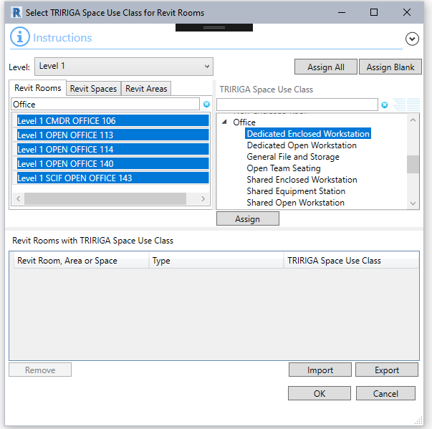
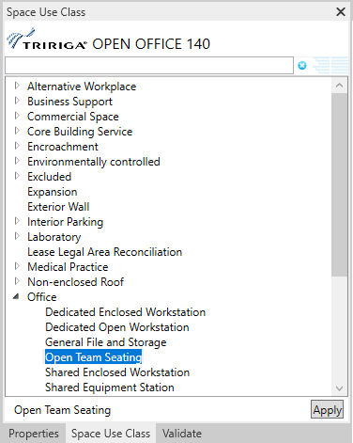
Space Use Class
Every Revit Room, Space, and Area that will be used to create a TRIRIGA space must have a Space Uses Class. Since the Connector does not know in advance how an element will be used, It requires every Room, Space and Area to have a Space Use Class. There are two ways to set Space Use Class:
Bulk/Name search
Display the Space Use Class of a single selected Area, Room, or Space.
Assign Space Use Class to all selected Areas, Rooms, and Spaces.
Work with filtered lists of Room, Spaces and Areas.
Property Sheet/Revit Selection

Slide 14
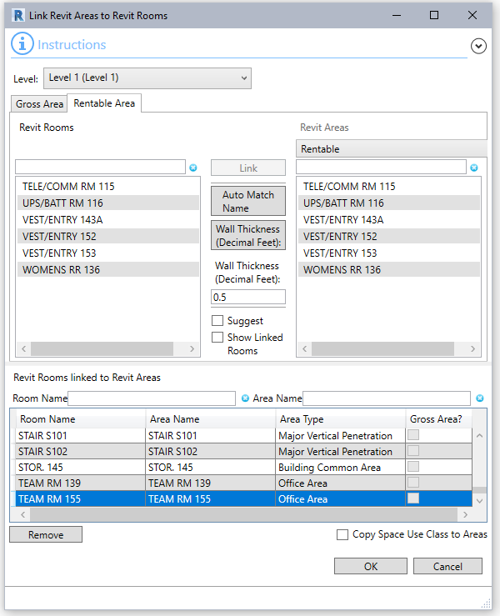
Mapping Areas to Rooms
Mapping Revit Areas to Revit Rooms provides better control of how TRIRIGA Space are is calculated.
Each Room can have one or more gross Areas mapped to it, and one or more area from a single rentable Area Plan.
There are 3 way to map Areas
Select a Room and 1 or more areas and hit link
Auto match by Name – Links Areas and Rooms with the same name
Auto match by location – Links Areas fully contained in a Room to that room
It is logical to only link Areas that are full contained within a Room to a Room, but this tool doesn’t enforce it
The Areas from Rooms tool automatically creates this mapping, and the Area tool automatically updates it
Tip: “Copy Space Use Class to Areas” can be used with existing mapping to update mapped Area’s Space Sue Class for the Room to which it is mapped.

Slide 15
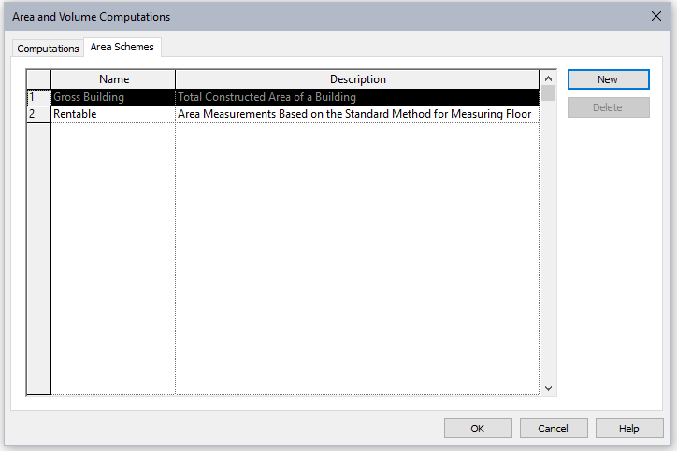

Areas from Rooms – Creating Area Schemes
The BIM Connector can automatically create Areas for a one-to-one Area to Room mapping by cloning room boundaries. This does not implement any area measurement standard, so it may be necessary to adjust area boundaries after the Areas are created.
To use this tool, and Area Scheme must already exist. To create an Area Scheme:
From the Architecture ribbon, select the “Room and Area” Drawer
Select “Area and Volume Computation”
Select the “Area Schemes” Tab
Select “New”
There is only one pre-defined Gross Building Area Scheme
There can be any number of Rentable Schemes. Each has its own set of Areas

Slide 16
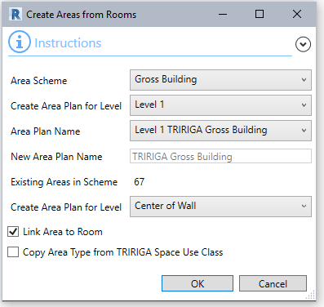
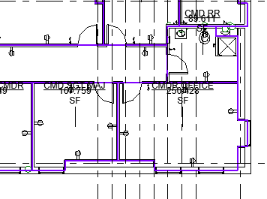
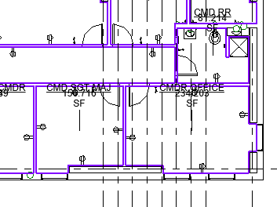
Areas from Rooms – Automatically Create Area Plan
There are two approaches to using the Area from Rooms tool: Let the tool create the Area Plan or manually create the Area Plan and edit the outer building perimeter after Areas are created
Starting without an existing Area Plan and letting the tool create it:
Select Areas Scheme
Select level. Typically this will be done for all integrated levels
Let the tool assign a name, or enter a name
Existing areas should be 0 for a new Area Plan
There are four options for how Revit can determine room boundaries. Area boundaries can be generated from any. Select the one that best aligns with how the Areas will be used.
“Link Areas to Room” auto-populates that Area to Room Map
“Copy Area Type from TRIRIGA Space Use Class” Uses a mapping from the Revit Space Use Class BOMA value to the Revit Area Type to set the Area Type
Center of Wall
Areas are created with the name, number, and Space Use Class of the source room
The Area to Room mapping is automatically set when Areas are created.
Wall inner face

Slide 17
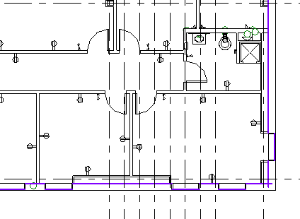
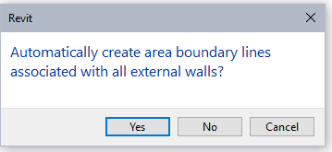
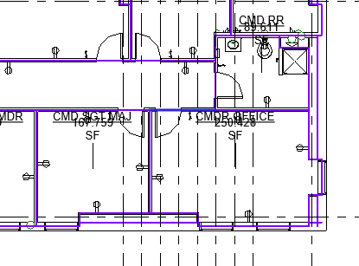
Areas from Rooms – Manually Create Area Plan
When Revit creates an Area Plan, it offer an option to create the area boundary lines associated with external walls. The results of this may differ from the results of cloning the Room exterior wall boundary line and may be more appropriate for your area management standard.
To create an Area Plan:
From the View Ribbon, Select Plan View -> Area Plan
Select the target Area Scheme
Select Yes to let Revit create exterior wall boundary lines. The new Area Pan is displayed.
In the “Create Areas from Rooms” tool, select the Area Plan created in the previous step
Edit exterior wall area boundary lines to remove duplicates
Revit Generated exterior wall boundary lines
Generated Area Plan
Areas added to manual Area Plan

Slide 18
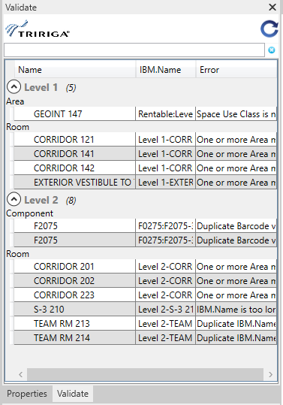
Validate
After the TRIRIGA components of the model are configured and before and elements are integrated with TRIRIGA, the TRIRIGA configuration should be validated.
The Connector provides an interactive property sheet for validation. When the property sheet is opened, model validation is initiated as a background process. For a large model, this may take several minutes.
Rerun validate
Double click to view element with error

Slide 19
Validation Rules
Project Information
IBM.BuildingName, and the IBM.ModelName parameters have values
IBM.BuildingName, and the IBM.ModelName don’t contain the # character
IBM.BuildingName, and the IBM.ModelName don’t exceed 150 characters in length
Levels
All levels have a value in their IBM.Name parameter
There are no duplicate values for the IBM.Name parameter in the list of levels
The value of the IBM.Name parameter for all levels does not exceed 50 characters.
That any Gross or Rentable Area Scheme referenced by the Level exists in the model
Rooms
All Rooms have a value in their IBM.Name parameter
There are no duplicate values for the IBM.Name parameter in the list of Rooms on each level
The value of the IBM.Name parameter for all Rooms does not exceed 100 characters.
All Rooms have a value for IBM.UseClassification
The IBM.UseClassification value is in the list of Use Classifications stored in the model
All the Areas referenced by the area lists in the IBM.GrossAreaSource and the IBM.RentableAreaSource reference Areas that exist in the model
All the Areas referenced by the area lists in the IBM.GrossAreaSource and the IBM.RentableAreaSource are placed (Have an area greater than 0.0)
Spaces
All Spaces have a value in their IBM.Name parameter
There are no duplicate values for the IBM.Name parameter in the list of Spaces on each level
The value of the IBM.Name parameter for all Spaces does not exceed 100 characters.
All Spaces have a value for IBM.UseClassification
The IBM.UseClassification value is in the list of Use Classifications stored in the model

Slide 20
Validation Rules
Areas
All Areas have a value in their IBM.Name parameter
There are no duplicate values for the IBM.Name parameter in the list of Areas for the combination of Area Scheme and Level.
The value of the IBM.Name parameter for all Areas does not exceed 100 characters.
All Areas have a value for IBM.UseClassification
The IBM.UseClassification value is in the list of Use Classifications stored in the model
Types
All Types have a value in their IBM.Name parameter
There are no duplicate values for the IBM.Name parameter in the list of Types
The value of the IBM.Name parameter for all Types does not exceed 100 characters.
Family Instance/Component
All Components have a value in their IBM.Name parameter
There are no duplicate values for the IBM.Name parameter in the list of Components
The value of the IBM.Name parameter for all Components does not exceed 100 characters.
All Components have a value in their IBM.BarCode parameter
There are no duplicate values for the IBM.BarCode parameter in the list of Components

Slide 21
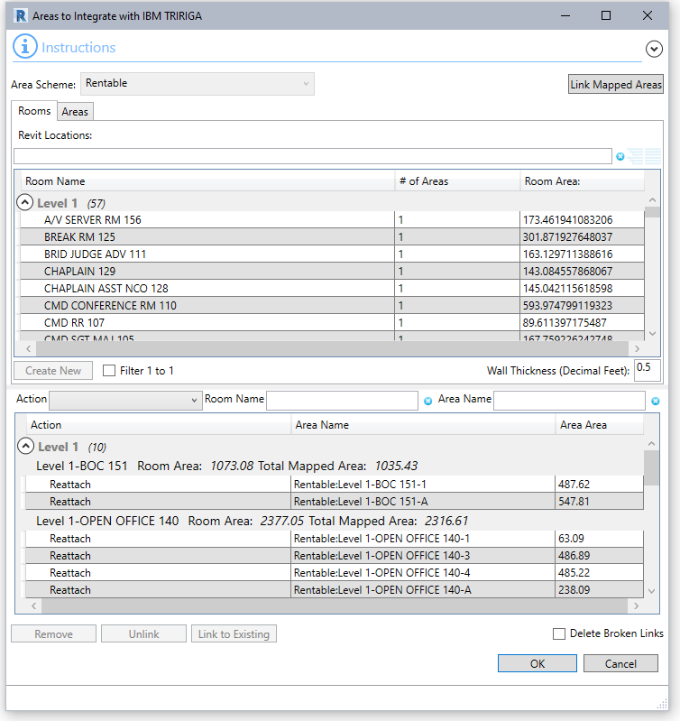
TRIRIGA Sub-spaces from Revit Areas
A sub-space is a space that has another space as its parent instead of a Floor.
The BIM Connector can create sub-spaces from Areas that are wholly contained within a room. This is generally only required when a room has been subdivided into many spaces.
Rooms –
Use this tab when creating a new building in TRIRIGA or to create sub-spaces for rooms that do not currently have any.
Selected the rooms for which sub-space are to be created, and push “Create New”. Sub-spaces will be created for ever contained Area.
Sometimes Room boundaries and Area boundaries are defined differently, such as Room to inside face of wall and Areas to center of wall. The “Wall Thickness setting allows you to adjust for this.
Areas –
Use this tab when linking to an existing model that has sub-spaces already defined. It allows manual matching of Revit Area to Sub-space
Use this tab to examine what Areas are contained in a Room.

Slide 22
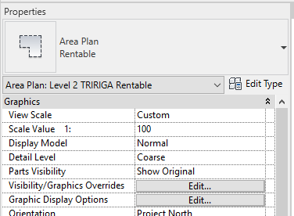
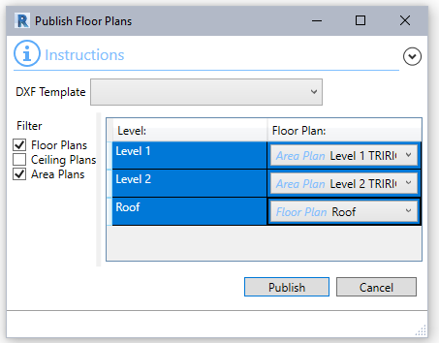
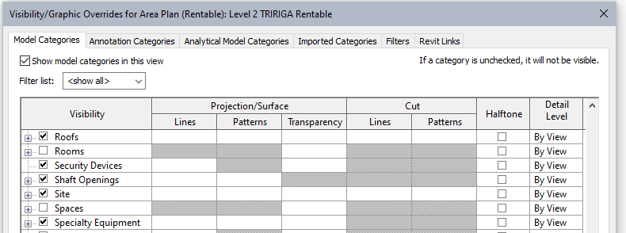
Publish Area Plan
Setting Visibility Options –
For Area Plans to publish correctly Rooms and Spaces must be hidden
From the Area Plan property sheet select Edit Visibility/Graphics Overrides
Uncheck visibility for Rooms and Spaces
Publish Area Plan –
Area Plans can be used instead of Floor Plans in the TRIRIGA graphics section. To Publish an Area Plan, Use the Publish Floor Plan tool, enable Area Plans, and select the desired Area Plan, Usually the rentable plan.

Slide 23
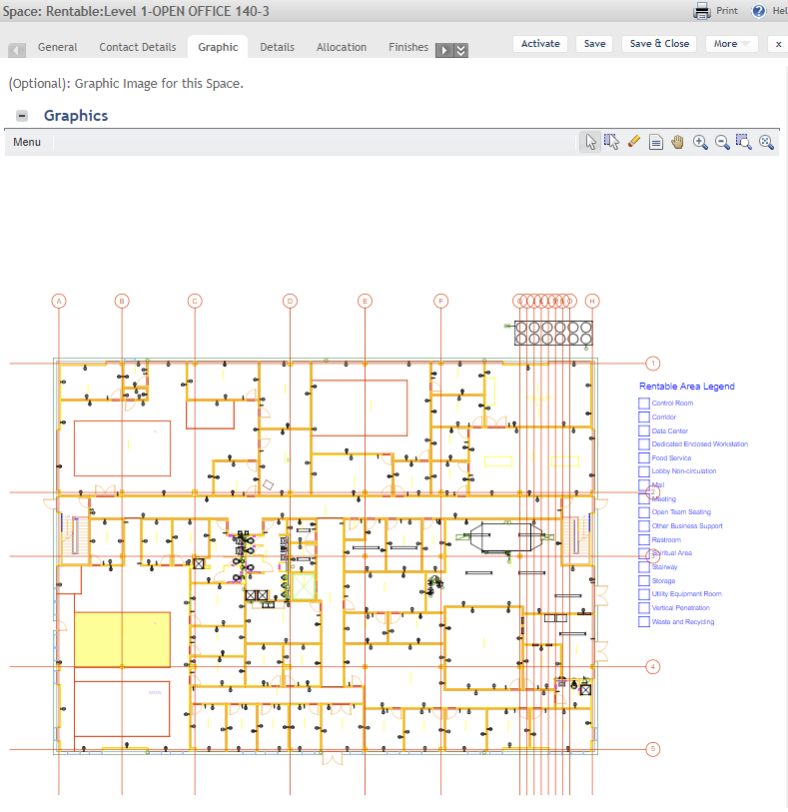
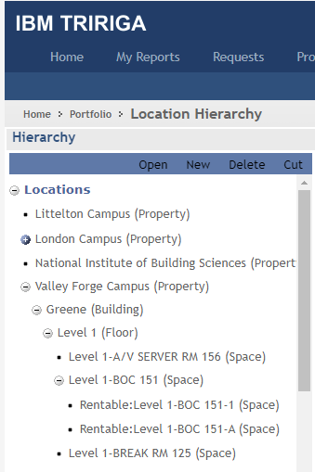
TRIRIGA Results

